Slide 1
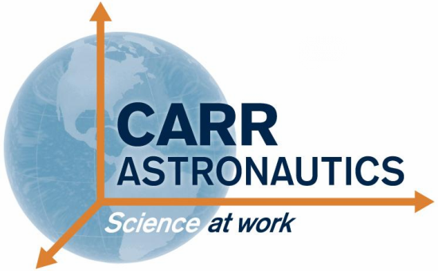
Beta Maturity TEMPO Datasets
TEMPO at Night
J. Carr¹, H. Chong², X. Liu²,
D. Flittner³, J. Houck²,
V. Kalb⁴, H. Madani¹, D. Wu⁴
August 26, 2024
jcarr@carrastro.com
¹Carr Astronautics, Greenbelt, MD
²SAO, Cambridge, MA
³NASA/LaRC
⁴NASA/GSFC
Support: TEMPO Program &
NASA/ESTO AIST-21-0043

Slide 2
TEMPO at Night
Aloha!
TEMPO Nighttime Science is Bonus Science!
Nighttime Signals are very Small: Challenging Work!
Example Use Cases
  City Lights (4-5 orders of magnitude dimmer than daytime)
  Moonlit Clouds (even dimmer)
  Aurora and Nightglow (extremely dim)
Using TEMPO Nighttime Data
  “Twilight” Radiance L1b Files (RADT V3)
  Cleaning & Background Subtractions (Python)
  Registration with VIIRS-DNB (MATLAB)
Big effort in L0-to-1 Processing to Optimize Dark Current Subtraction
These will be/are Available on GitHub

Slide 3
Sun Safety Limits
Nighttime Observing by Solar Time at Satellite Longitude (91°W)
Sun eclipsed
by Earth (umbra)
Allowed
nighttime
observing
Aperture door closed
while sun is < 60°
from optical axis
Daylight
Satellite Midnight

Slide 4
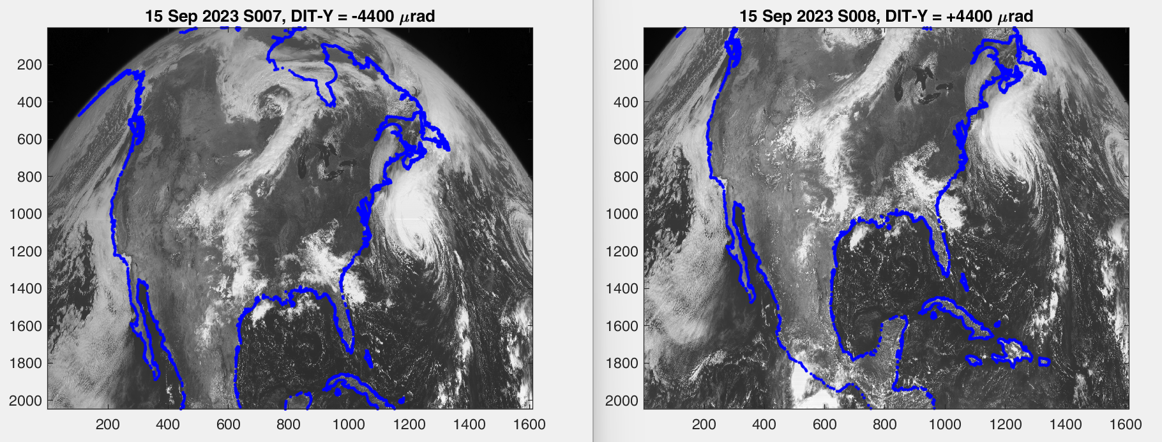
Full Field of Regard
Daytime Imagery for Context
Tilt North
Tilt South
Maximum Scan Range
Maximum Scan Range

Slide 5
Clearest-Sky Composite
nW/(cm² sr)
Moonless February 2024 Nights
Integrated: 540 nm to 640 nm

Slide 6
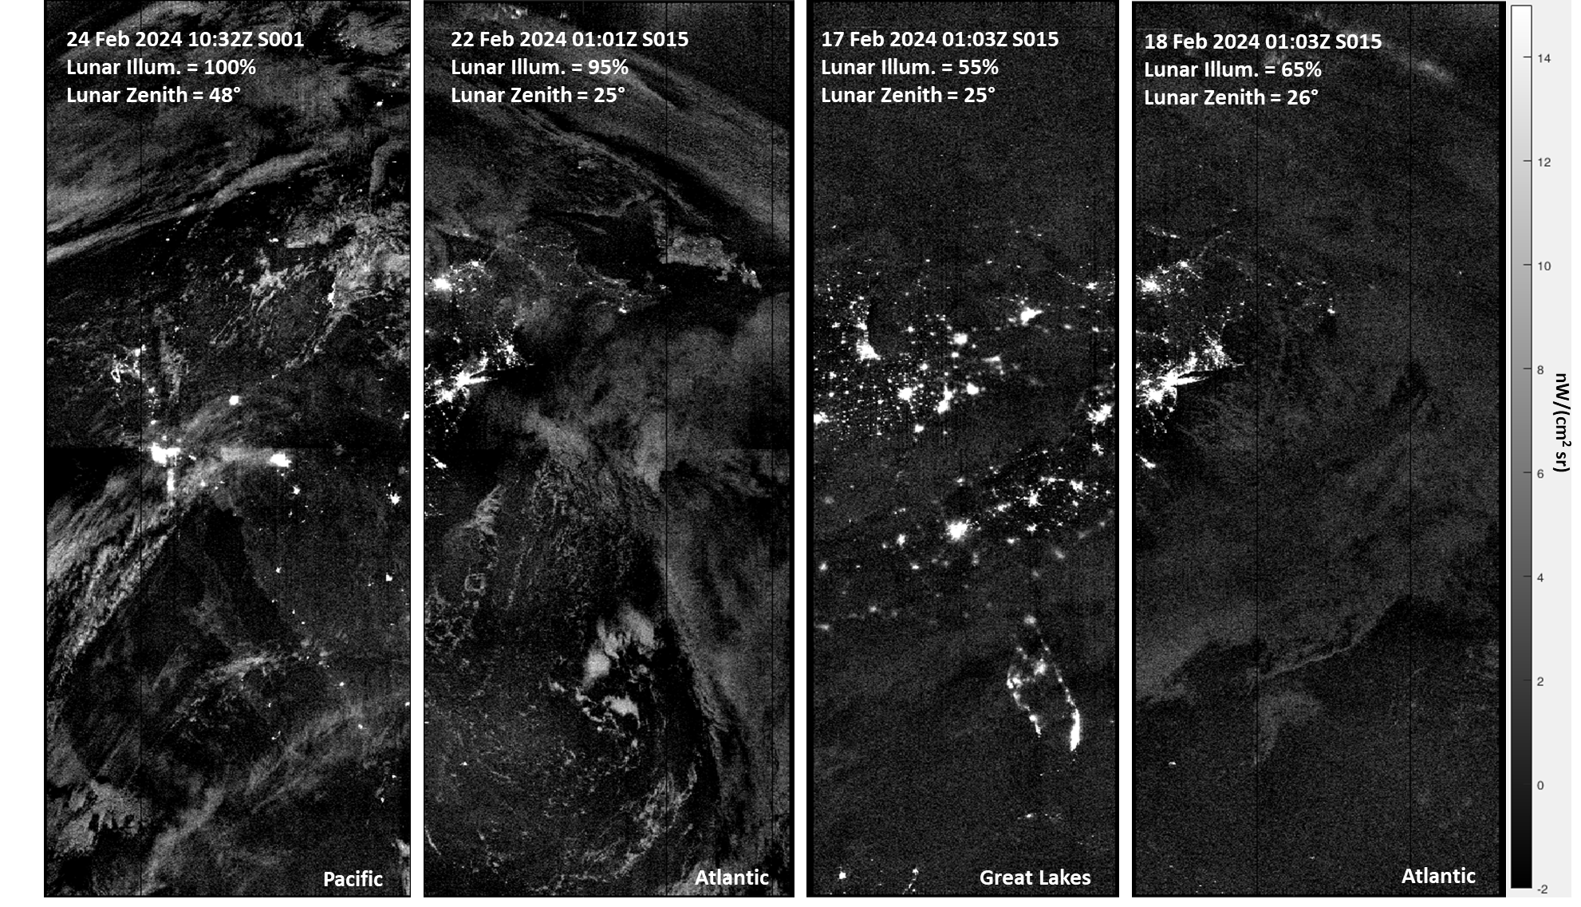
Clouds in the Moonlight

Slide 7
City Lights Classification

Slide 8
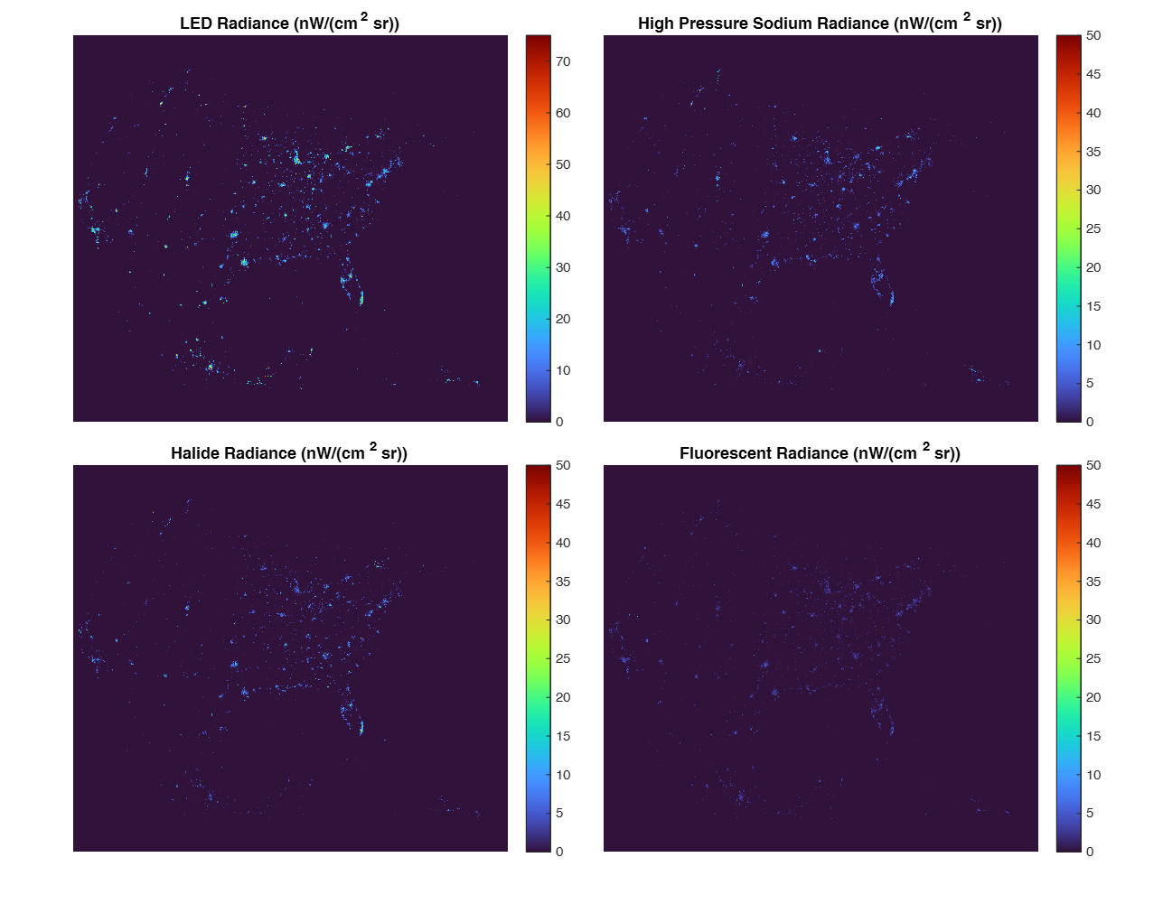
City Lights Classification

Slide 9
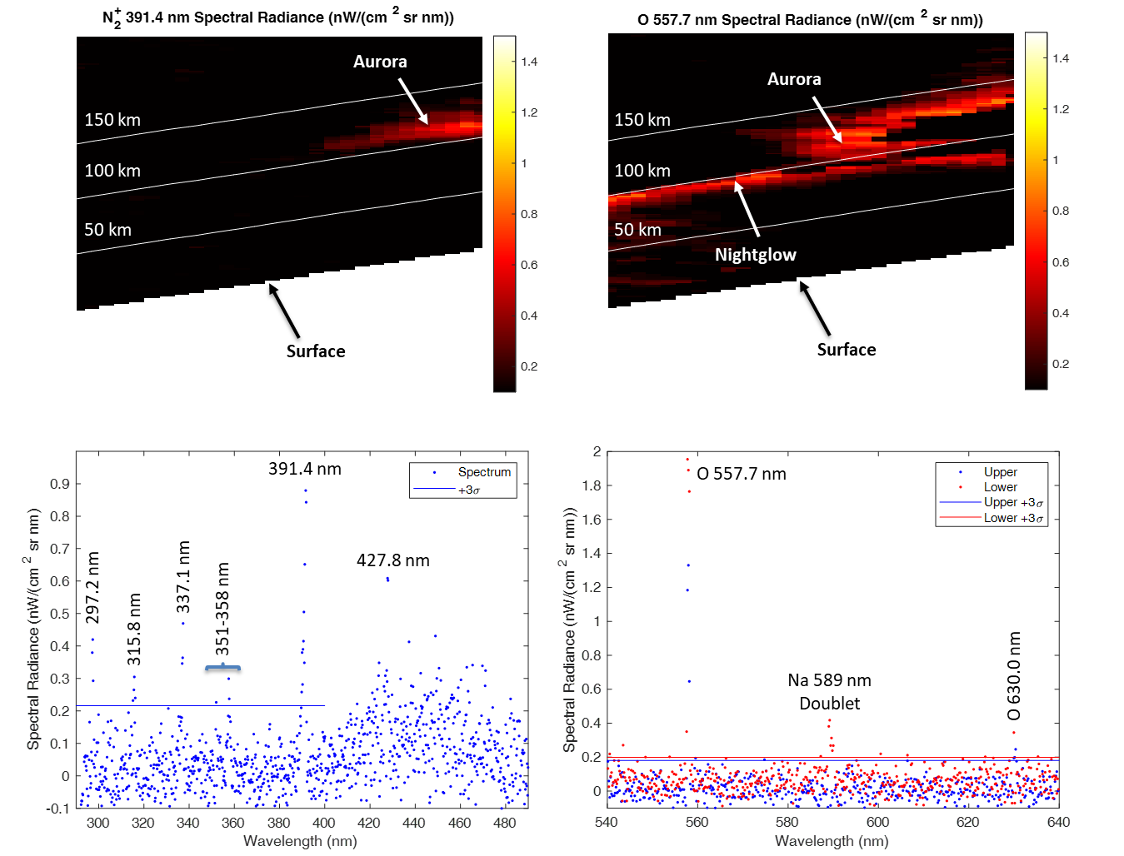
Aurora & Nightglow
120 s Exposures
Spatially Averaged UV Spectrum
Spatially Averaged VIS Spectrum

Slide 10
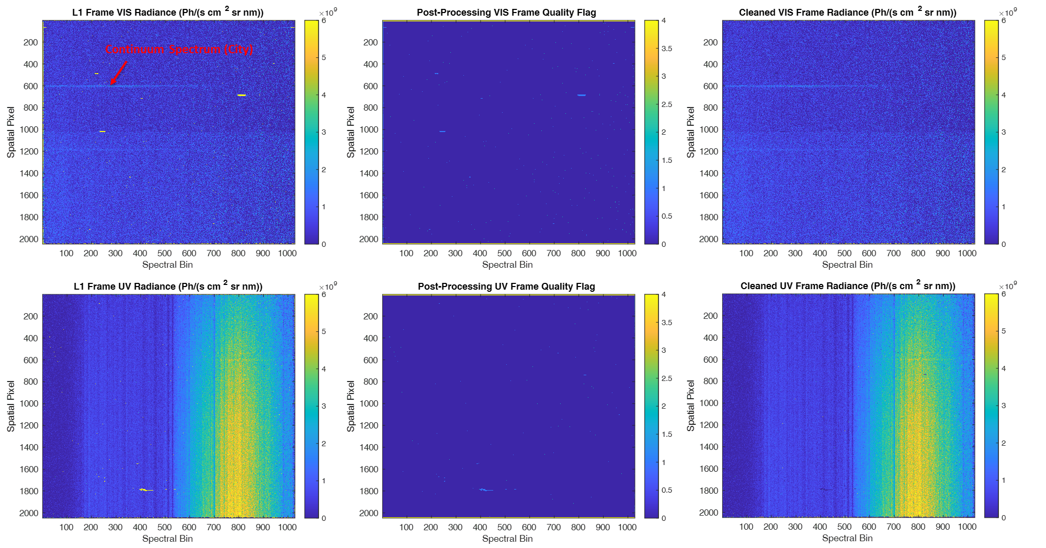
Post-Processing: Cleaning
Science with TEMPO Nighttime Data is a lot of Work!*
*Fortunately, we have tools in Python and MATLAB to do this work on RADT files.

Slide 11
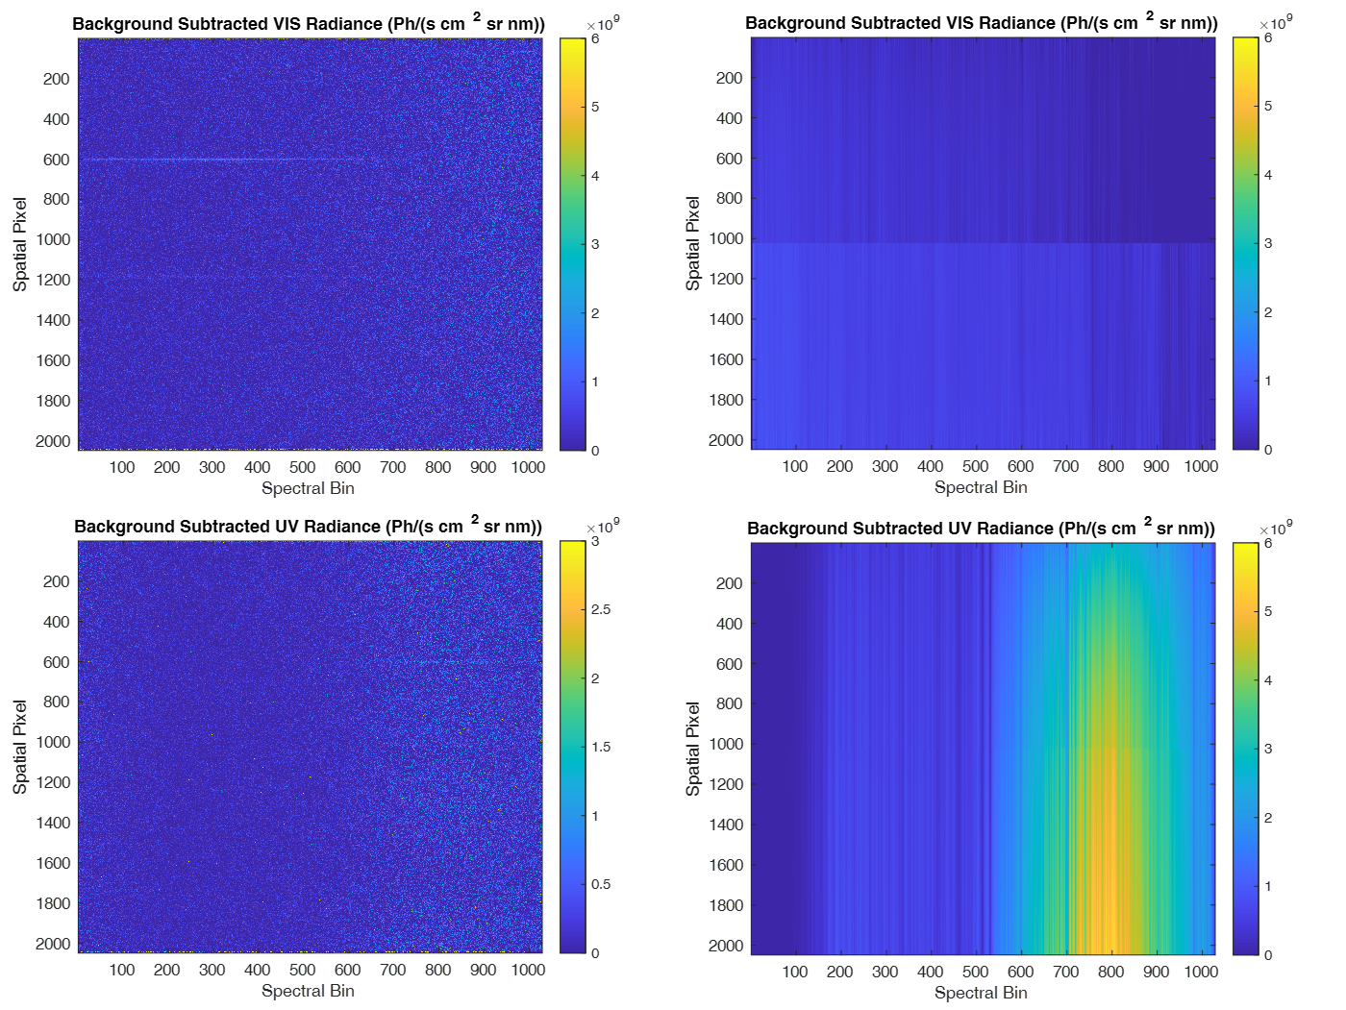
Background Subtraction

Slide 12
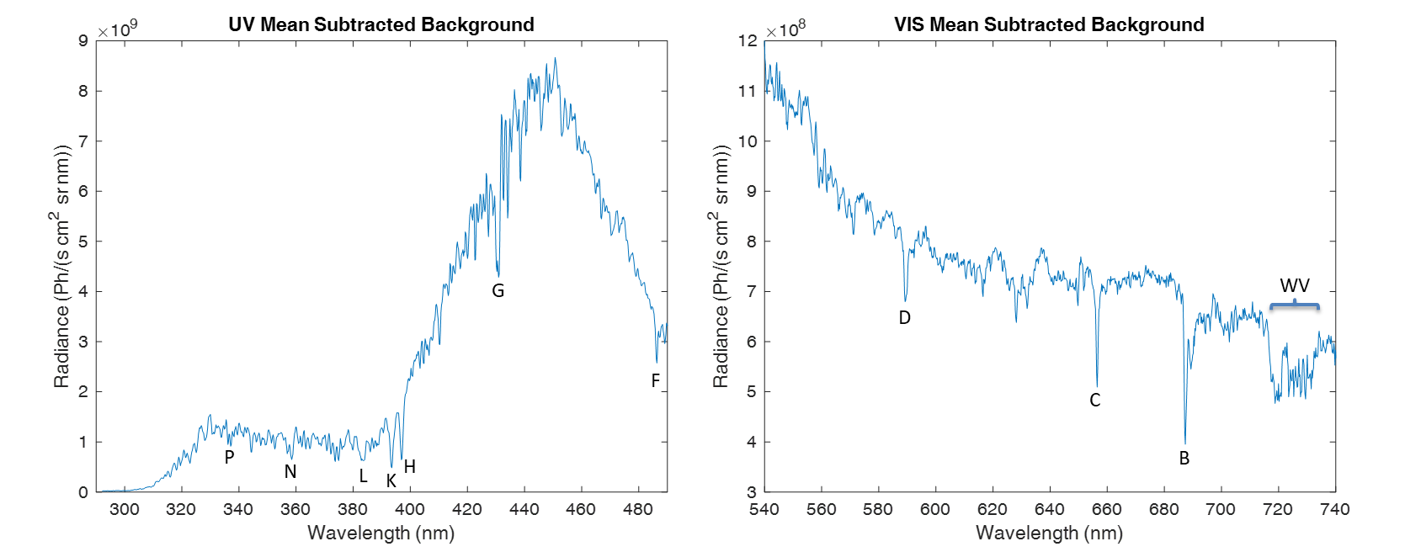
Subtracted Background
Background Light shows Solar (Fraunhofer) and Atmospheric Scattering/Absorption Features
Granule
This is why we call the Nighttime L1b “Twilight” Radiances (RADT)
Lunar Glint
Sun
Solar/Lunar Terminators
Moon

Slide 13
Reregistration with VIIRS
TEMPO
VIIRS
TEMPO Navigation is “nominal” without benefit of INR processing to precisely register it with GOES-R Reference Imagery (“INR Truth”)
VIIRS-DNB Clear-Sky Composite used as “INR Truth”
TEMPO Bright Spots matched to VIIRS-DNB
Biases Compensated by Adjusting the (Lat, Lon) coordinates in the TEMPO granule on a per scan basis
Adjusted (Lat, Lon) tested for quality
Implemented in MATLAB

Slide 14
Possible Investigations
Urbanization/City Spectra
Oil & Gas
Fishing
Aurora & Airglow
Space Objects
  Moon (easy!)
  Stars (bright ones)
  Satellites (e.g., Starlink @ 550 km)?
Nighttime Cloud Imaging
Nighttime Trace Gases & Aerosols

Slide 15
Mahalo!
Look for a Paper in Earth and Space Science Soon!

